Slide 1
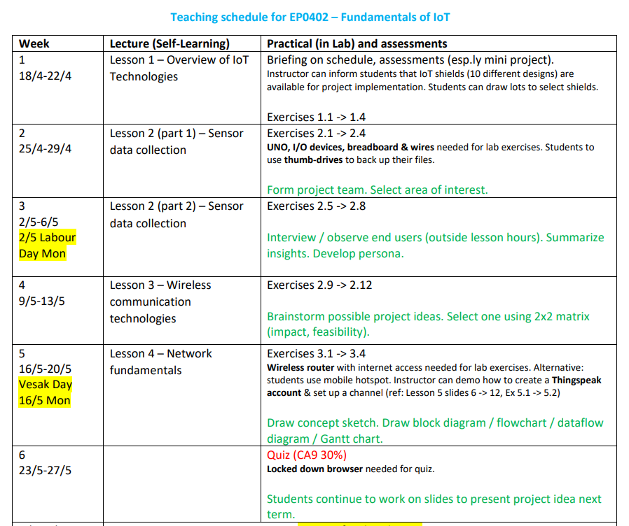

Slide 2
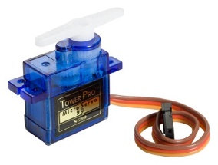
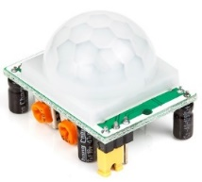

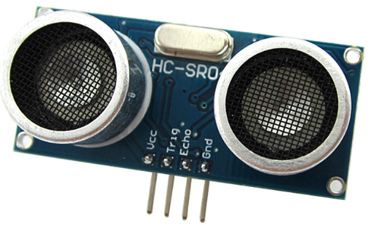
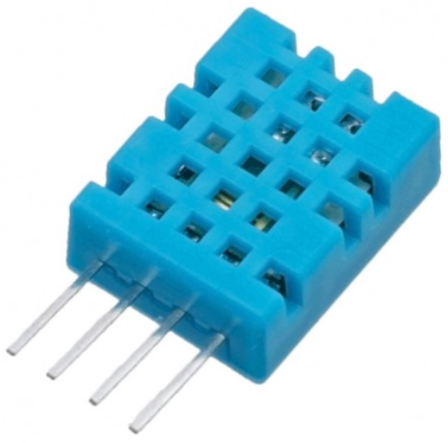
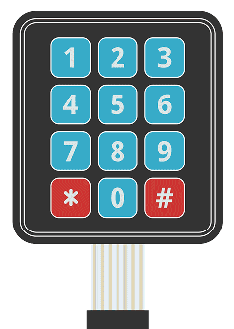
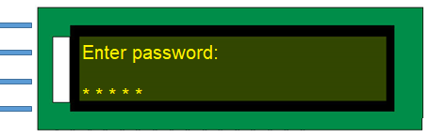
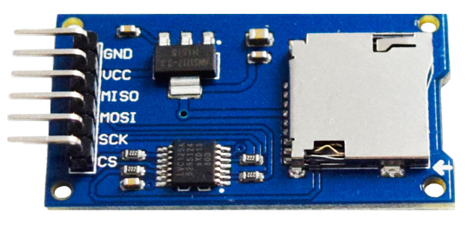
Exercise 2.5 – 2.12 – Trying out these I/O (Input/Output) devices
Exercise 2.5 – Servo motor – make it swing over 180 degree
Exercise 2.6 – PIR sensor – if motion is detected, turn on a buzzer (i.e. an “alarm”)
Exercise 2.7 – LDR – if it is dark, turn on an LED (i.e. a “lamp”)
Exercise 2.8 – Ultrasonic ranger – read the obstacle distance & display on the serial monitor
Exercise 2.9 – Temp. & Humidity Sensor – read the values & display on the serial monitor
Exercise 2.10 – Keypad – read the key pressed & display on the serial monitor
Exercise 2.11 – LCD – display a message e.g. “Enter password:” on line 1
Exercise 2.12 – SD card module – store a list of numbers on the SD card

Slide 3
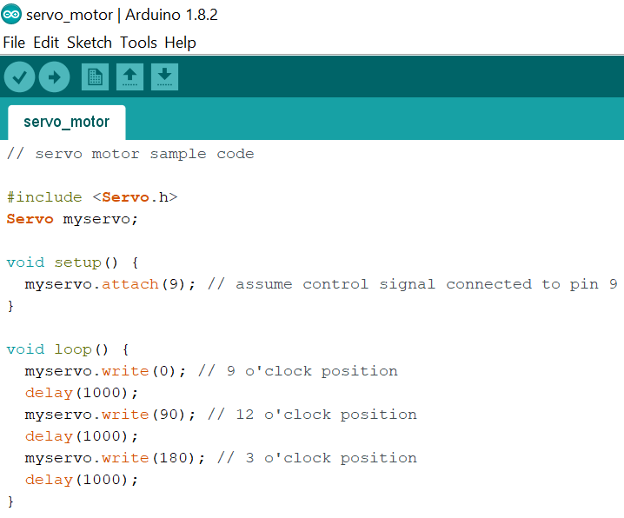
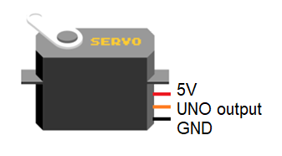

Servo motor
Exercise 2.5 – Servo motor – make it swing over 180 degree
Sample Code
Intro
The arm of a servo motor can be made to swing over 180 degree i.e. from 9 o’clock to 3 o’clock positions.
It is to be connected as shown below: the GND wire can be black or brown, the control signal wire can be orange or yellow.
It may look like this.
Connection
Applications
Position control
Sorting / diverting
Remote control car/boat/aeroplane

Slide 4
Sample Code
// servo motor sample code
#include <Servo.h>
Servo myservo;
void setup() {
myservo.attach(9); // assume control signal connected to pin 9
}
void loop() {
myservo.write(0); // 9 o'clock position
delay(1000);
myservo.write(90); // 12 o'clock position
delay(1000);
myservo.write(180); // 3 o'clock position
delay(1000);
}

Slide 5
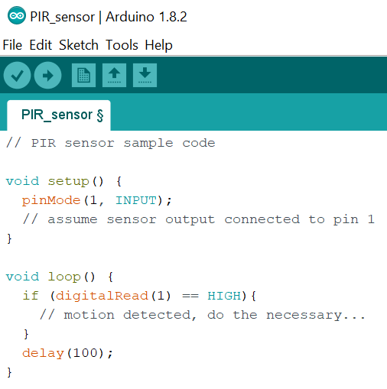
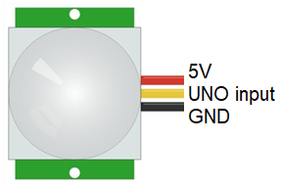
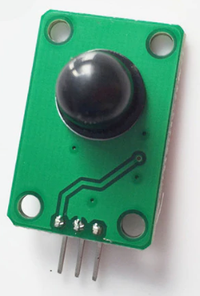
PIR sensor
Applications
Intruder detection
Energy saving light
Automated greeting
Intro
A PIR (Passive Infra Red) sensor can be used to detect motion of an animal or a human.
Powered up as shown below, if motion is detected, the UNO will read a HIGH. If there is no motion, the UNO will read a LOW.
Sample Code
It may look like this.
Connection

Slide 6
Sample Code
// PIR sensor sample code
void setup() {
pinMode(1, INPUT);
// assume sensor output connected to pin 1
}
void loop() {
if (digitalRead(1) == HIGH){
// motion detected, do the necessary...
}
delay(100);
}

Slide 7
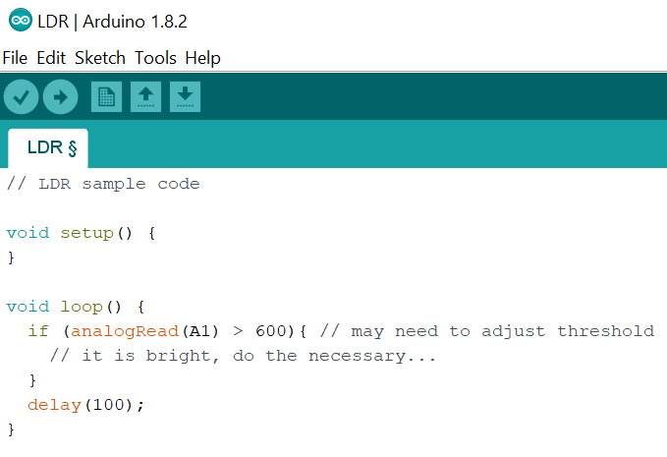
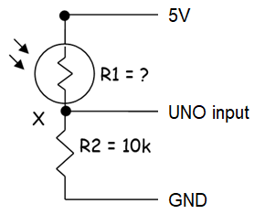
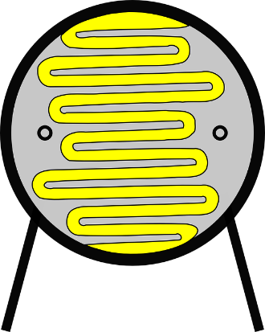
LDR (Light Dependent Resistor)
Sample Code
Intro
The resistance of an LDR decreases, with increasing light intensity.
Connected as shown below, if it is bright, the UNO will read a high value. If it is dark, the UNO will read a low value. Range: 0 – 1023.
Applications
Connection
Automatic lighting
Smoke detection
Burglar alarm system
analogRead result =
1023 * V_{X} / 5V
Voltage division
Voltage at X, V_{X} =
5V * 10k / (10k + R1)
It may look like this.

Slide 8
Sample Code
// LDR sample code
void setup() {
}
void loop() {
if (analogRead(A1) > 600){ // may need to adjust threshold
// it is bright, do the necessary...
}
delay(100);
}

Slide 9
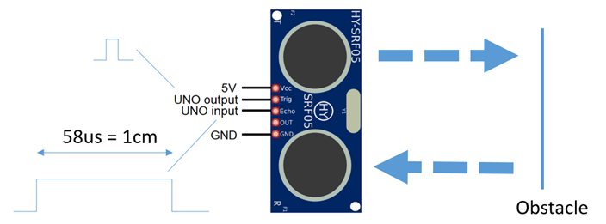
Ultrasonic Ranger
Intro
Ultrasound, which human can’t hear, can be used to measure distance.
When a short pulse is produced at Trig by the UNO, the transmitter will send a pulse train out. This will be reflected by the obstacle. From the time of flight (divided by 2!) & the speed of ultrasound, the obstacle distance can be computed.
The distance is conveyed to the UNO at Echo, in the form of a high pulse. Every 58 us is equivalent to 1 cm of obstacle distance.
Applications
Obstacle detection
Height / distance measurement
Connection
Sample Code
See next page…

Slide 10
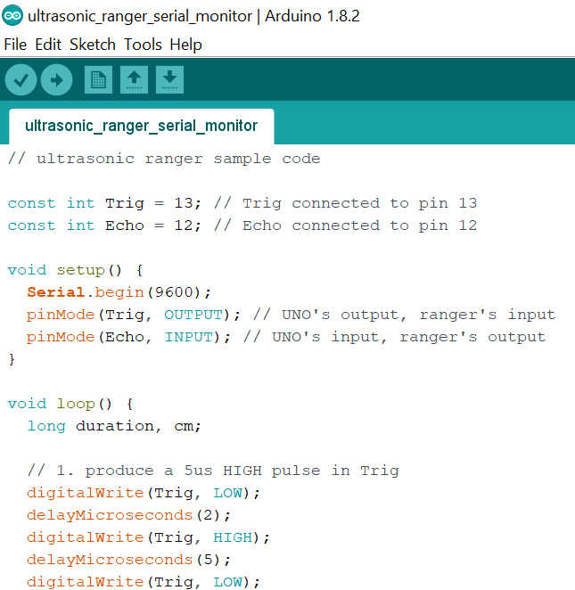
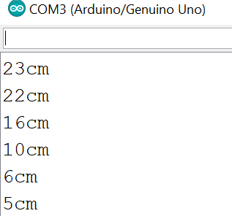
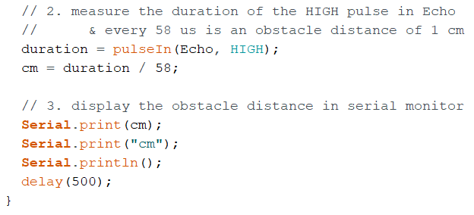
Ultrasonic Ranger (cont.)
Sample Code
Sample Code
The obstacle distance is displayed on the serial monitor.

Slide 11
// ultrasonic ranger sample code
const int Trig = 13; // Trig connected to pin 13
const int Echo = 12; // Echo connected to pin 12
void setup() {
Serial.begin(9600);
pinMode(Trig, OUTPUT); // UNO's output, ranger's input
pinMode(Echo, INPUT); // UNO's input, ranger's output
}
void loop() {
long duration, cm;
// 1. produce a 5us HIGH pulse in Trig
digitalWrite(Trig, LOW);
delayMicroseconds(2);
digitalWrite(Trig, HIGH);
delayMicroseconds(5);
digitalWrite(Trig, LOW);
// 2. measure the duration of the HIGH pulse in Echo
// & every 58 us is an obstacle distance of 1 cm
duration = pulseIn(Echo, HIGH);
cm = duration / 58;
// 3. display the obstacle distance in serial monitor
Serial.print(cm);
Serial.print("cm");
Serial.println();
delay(500);
}
Sample Code

Slide 12
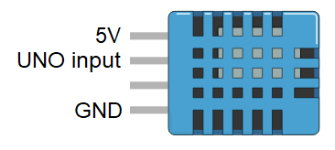
Temp & Humidity Sensor
Intro
DHT11 is one such sensor that can measures temperature from 0 to 50 degree Celsius (with 2 degree accuracy) & humidity from 20 to 80 % (with 5% accuracy).
It uses a single wire to send the data serially – precise timing is required.
Download & install the DHT11 library & sensor library from https://github.com/adafruit/DHT-sensor-library
https://github.com/adafruit/Adafruit_Sensor
See the Appendix on how a library can be installed.
A 10k pull up resistor may be needed for this pin.
Connection
Applications
Sample Code
Environment monitoring
Automation
See next page…

Slide 13
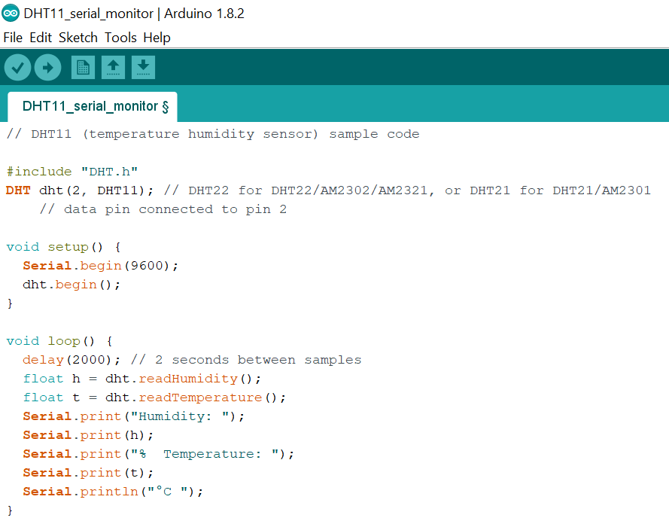
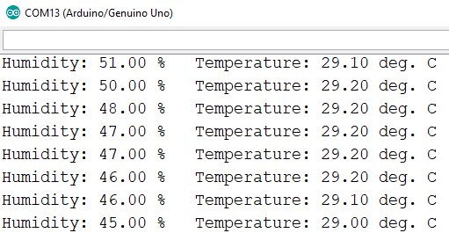
Temp & Humidity Sensor (cont.)
Sample Code / Run

Slide 14
// DHT11 (temperature humidity sensor) sample code
#include "DHT.h"
DHT dht(2, DHT11); // DHT22 for DHT22/AM2302/AM2321, or DHT21 for DHT21/AM2301
// data pin connected to pin 2
void setup() {
Serial.begin(9600);
dht.begin();
}
void loop() {
delay(2000); // 2 seconds between samples
float h = dht.readHumidity();
float t = dht.readTemperature();
Serial.print("Humidity: ");
Serial.print(h);
Serial.print("% Temperature: ");
Serial.print(t);
Serial.println("°C ");
}
Sample Code

Slide 15
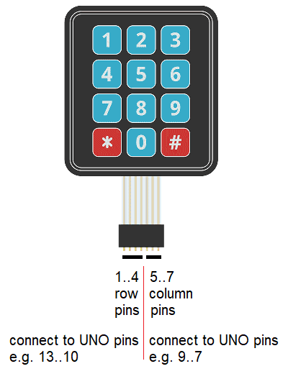
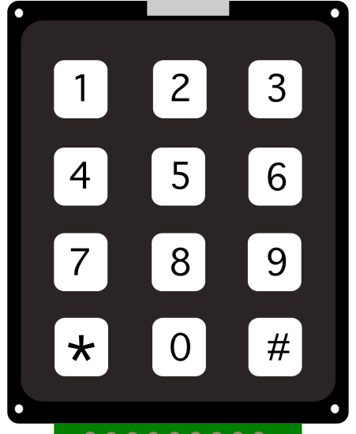
Keypad
Connection
It may also look like this.
Intro
A keypad can be used to enter numbers 0-9, * and #.
A 4x3 keypad consists of 12 switches.
However, the scanning algorithm in the keypad library treats it as 4 row signals + 3 column signals.
So, if you press ‘8’, 3rd row is connected to 2nd column etc.
Download & install the keypad library from http://playground.arduino.cc/Code/Keypad
Applications
Sample Code
Entering password
Configuring system
Making choices from a menu / selection
See next few pages…

Slide 16
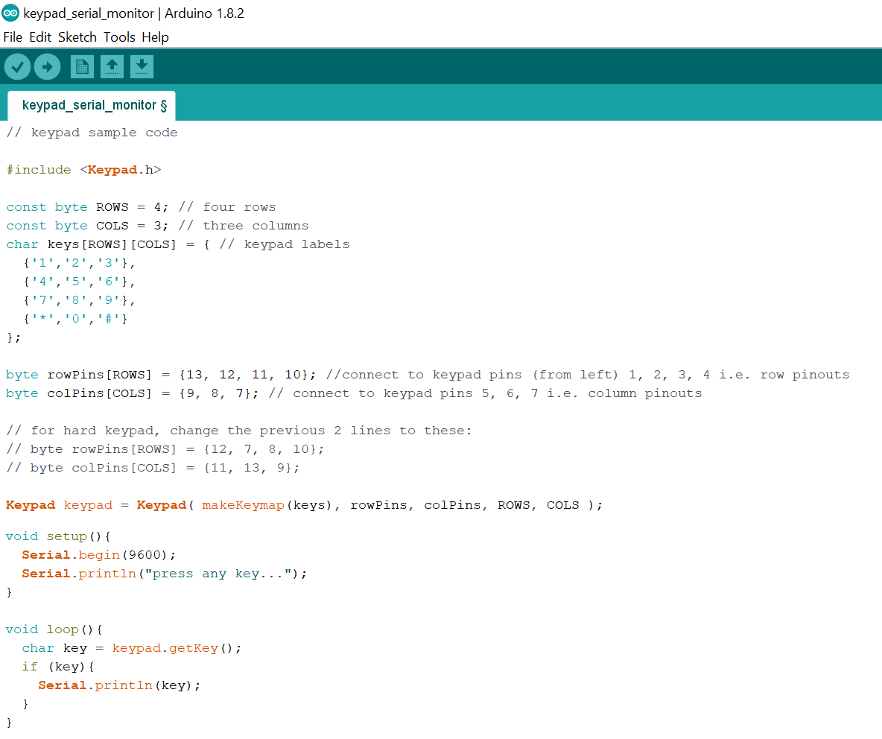
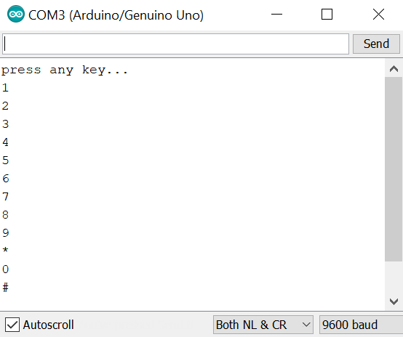
Keypad (cont.)
Sample code
Press each key, and you will see this in the serial monitor.
for hard keypad, change to:
byte rowPins[ROWS] = {12, 7, 8, 10};
byte colPins[COLS] = {11, 13, 9};

Slide 17
// keypad sample code
#include <Keypad.h>
const byte ROWS = 4; // four rows
const byte COLS = 3; // three columns
char keys[ROWS][COLS] = { // keypad labels
{'1','2','3'},
{'4','5','6'},
{'7','8','9'},
{'*','0','#'}
};
byte rowPins[ROWS] = {13, 12, 11, 10}; //connect to keypad pins (from left) 1, 2, 3, 4 i.e. row pinouts
byte colPins[COLS] = {9, 8, 7}; // connect to keypad pins 5, 6, 7 i.e. column pinouts
// for hard keypad, change the previous 2 lines to these:
// byte rowPins[ROWS] = {12, 7, 8, 10};
// byte colPins[COLS] = {11, 13, 9};
Keypad keypad = Keypad( makeKeymap(keys), rowPins, colPins, ROWS, COLS );
void setup(){
Serial.begin(9600);
Serial.println("press any key...");
}
void loop(){
char key = keypad.getKey();
if (key){
Serial.println(key);
}
}
Sample Code

Slide 18
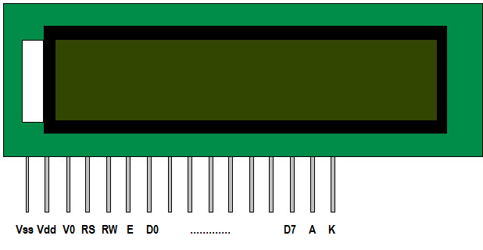
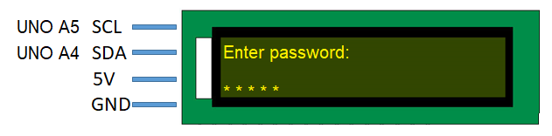
LCD (TWI)
It may also look like this.
Intro
An LCD can be used to prompt for password, or display info & instruction etc.
We will use the 4-pin version below, to reduce the number of UNO pins needed for connection.
FYI, this is using TWI (or Two Wire Interface – not very easy to understand).
Download & install the LCD library as follows:
Google “Arduino TWI LCD Library”
Download “LiquidCrystal_I2C-1.1.2.zip” file from Arduino.cc
In Arduino IDE, click “Sketch – Include Library – Add .ZIP Library”.
Adjust the number of rows and columns in the sample sketches to 16 & 2.
Applications
Info / instruction display
Password prompt
Connection
Sample Code
See next few pages…

Slide 19
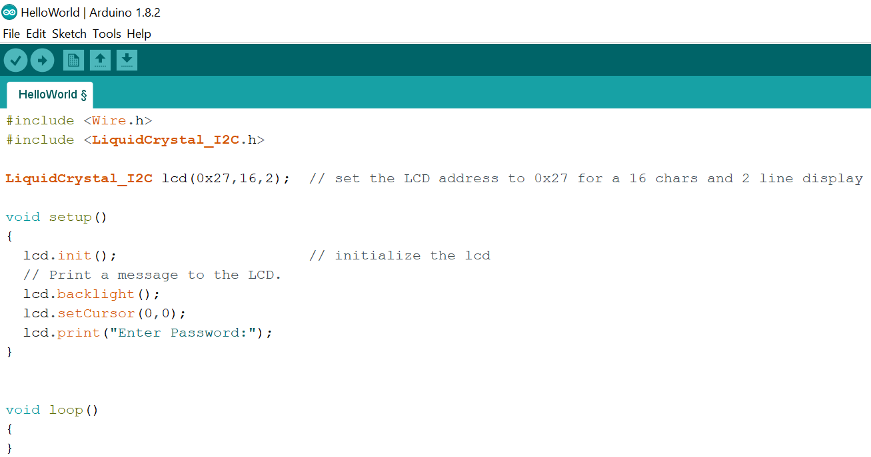
LCD (TWI) (cont.)
Sample code
Modify the sketch File -> Examples -> LiquidCrystalI2C -> HelloWorld to this:
16 x 2 LCD.
Try 0x3F or 0x27.
How code is organised depends on your application.

Slide 20
// TWI LCD sample code
#include <Wire.h>
#include <LiquidCrystal_I2C.h>
LiquidCrystal_I2C lcd(0x3F, 2, 1, 0, 4, 5, 6, 7, 3, POSITIVE);
// addr,en,rw,rs,d4,d5,d6,d7,bl,blpol
// addr can be 0x3F or 0x27
void setup()
{
lcd.begin(16, 2); // 16 characters, 2 lines
lcd.noBacklight(); // turn backlight off
delay(250);
lcd.backlight(); // turn backlight on
delay(250);
lcd.setCursor(0, 0); // position cursor at character 0, line 0
lcd.print("Enter password:");
delay(500);
lcd.setCursor(0, 1); // position cursor at character 0, line 1
for (int i=0; i<5; i++){
// read a character in the password
lcd.print("*"); // display as asterisk
delay(500);
}
delay(5000);
lcd.clear(); // clear display
// continue...
}
void loop()
{
// left blank
}
Sample Code

Slide 21
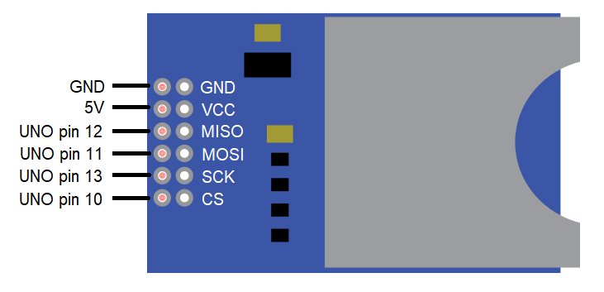
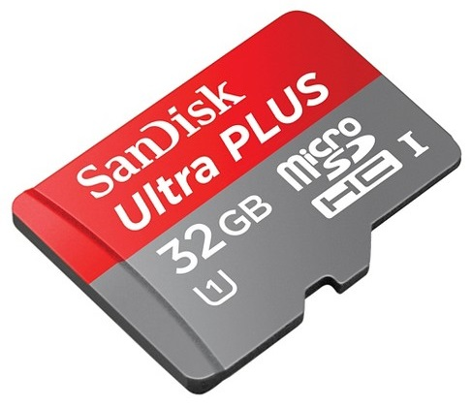
SD card module
Connection
Intro
An SD card module (together with an SD card) allows data to be stored locally.
FYI, this is using SPI (or Serial Peripheral Interface – not very easy to understand).
Luckily, an Arduino library is available to make programming manageable.
Sample Code
See next page…
Applications
Data logging
Storage of files for other modules e.g. mp3 player module / camera module
An SD card is to be inserted.

Slide 22
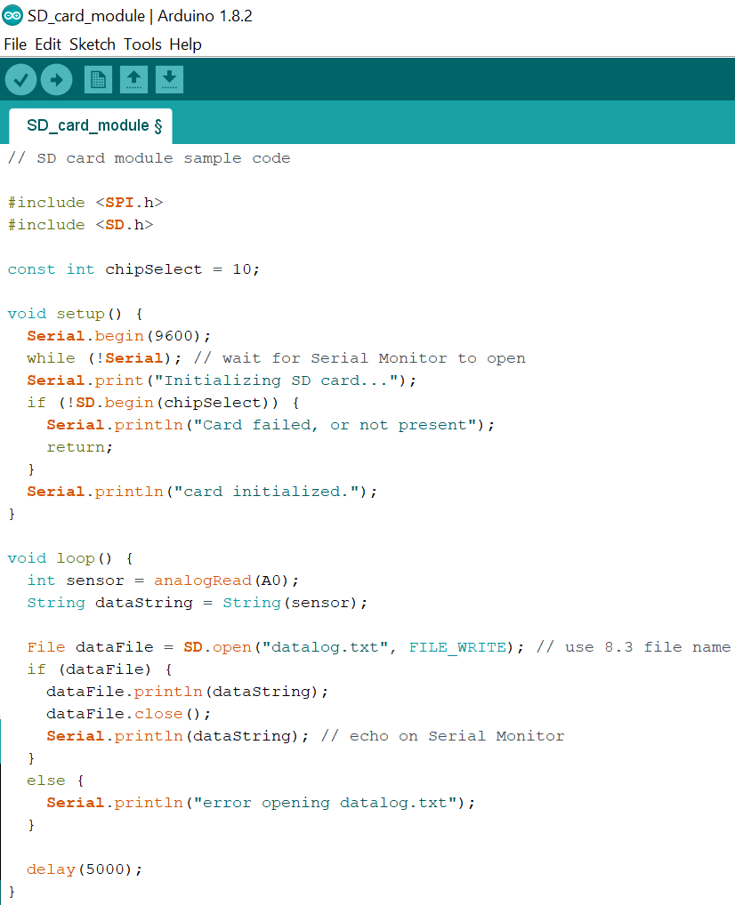
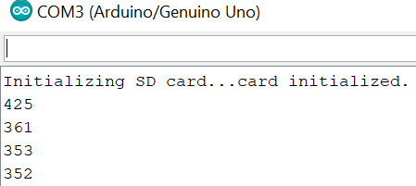
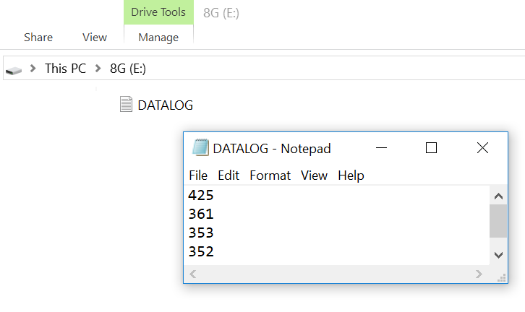
SD card module (cont.)
Sample Code
Serial Monitor when code is run.
datalog.txt file when opened on PC.

Slide 23
// SD card module sample code
#include <SPI.h>
#include <SD.h>
const int chipSelect = 10;
void setup() {
Serial.begin(9600);
while (!Serial); // wait for Serial Monitor to open
Serial.print("Initializing SD card...");
if (!SD.begin(chipSelect)) {
Serial.println("Card failed, or not present");
return;
}
Serial.println("card initialized.");
}
void loop() {
int sensor = analogRead(A0);
String dataString = String(sensor);
File dataFile = SD.open("datalog.txt", FILE_WRITE); // use 8.3 file name
if (dataFile) {
dataFile.println(dataString);
dataFile.close();
Serial.println(dataString); // echo on Serial Monitor
}
else {
Serial.println("error opening datalog.txt");
}
delay(5000);
}
Sample Code

